Slide 1
An introduction to Neuroimaging Statistics
Habib Ganjgahi
Department of Statistics
University of Oxford

Slide 2
Outline
Introduction to Neuroimaging
Structural
Functional
Population Neuroimaging
Human Connectome project
UKBIobank
Fingerprinting

Slide 3
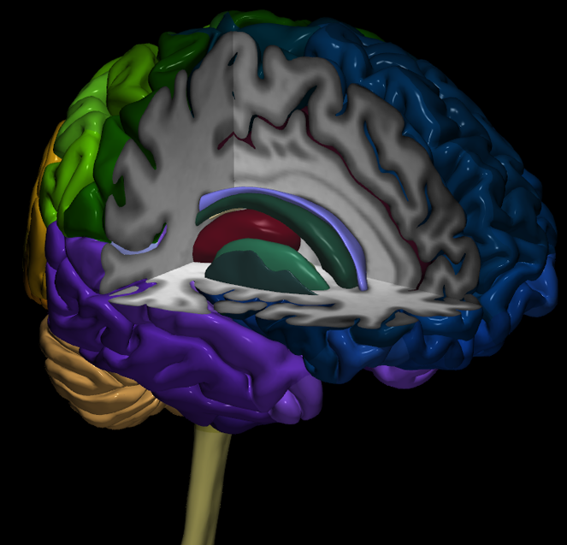
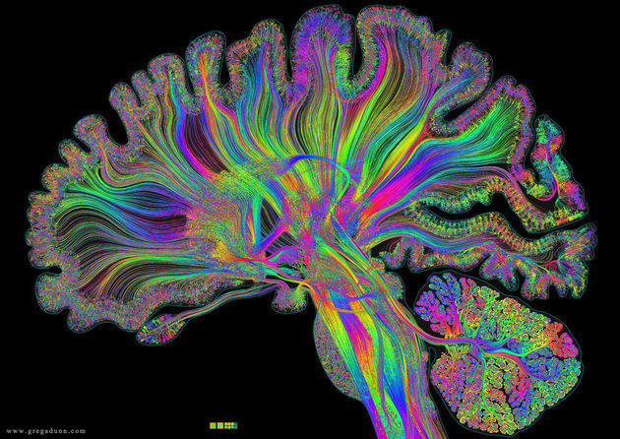
MRI data modalities: UKBB
Brain:
gray, white, Cerebrospinal fluid (CSF)
MRI: Non-invasive
Structural
T1 images: gray matter
Diffusion tensor imaging: white matter tractography
Functional
Task fMRI
Resting state

Slide 4
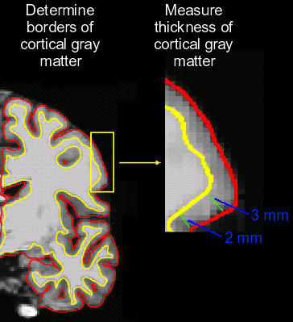
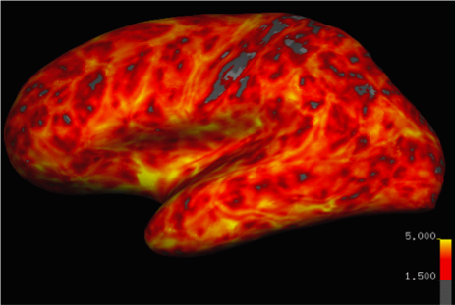
Structural MRI: Thickness
Gray matter: Cortical thickness, surface area

Slide 5
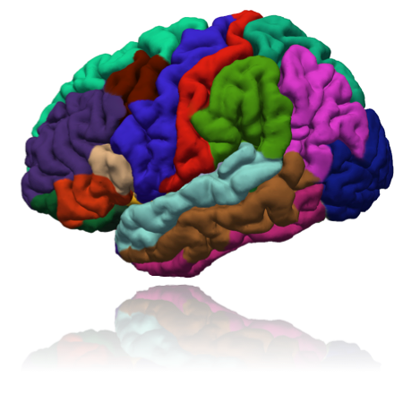
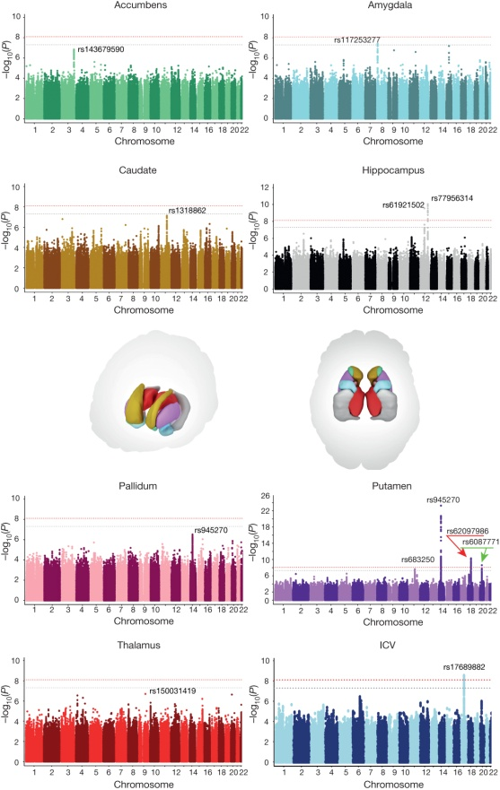
Structural MRI: volume
ROI: different atlases, different resolutions

Slide 6
Functional MRI: Task
fMRI experiment

Slide 7
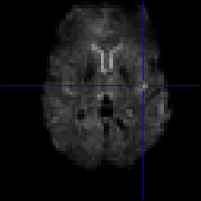
fMRI Perspective Massive Spatial Data
1,000
4-Dimensional Data
1,000 multivariate observations, each with 100,000 elements
100,000 time series, each with 1,000 observations
100 million data points per subject!
Requires custom, computationally efficient analysis tools
. . .
3
2
1
1 “voxel”
(3d pixel, or “volume element”)

Slide 8
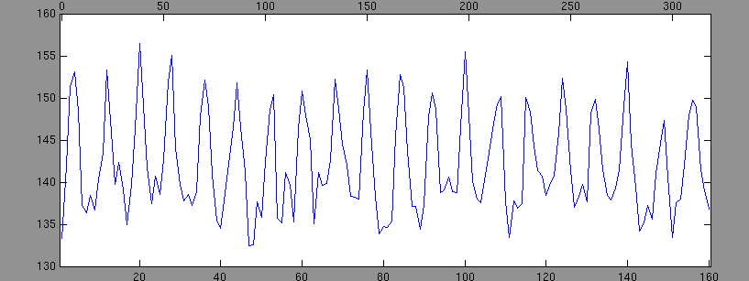
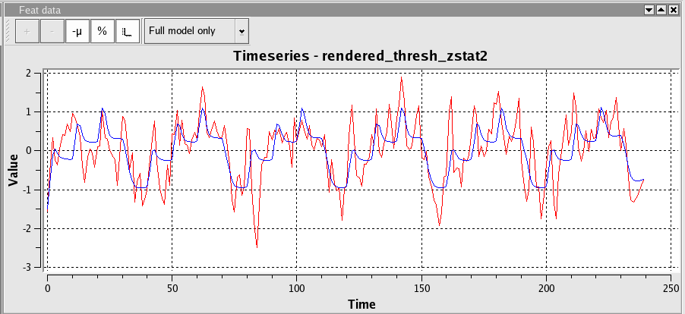
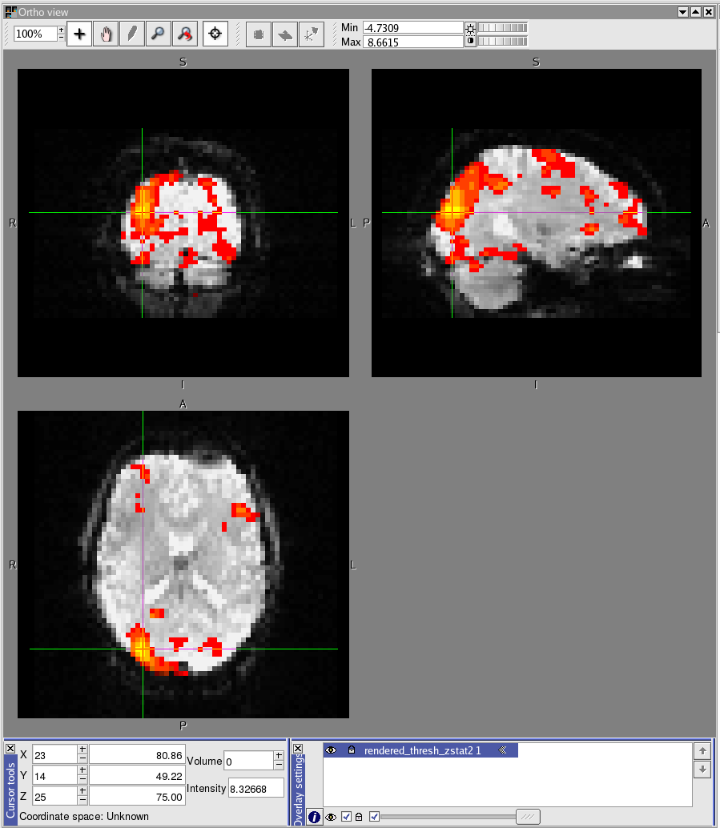
BOLD fMRI
Finger Tapping
Mass Univariate Model: Actually, just a simple regression model at each voxel
Tap fingers
Rest
Single fMRI Image
Thresholded T statistic image overlaid on single fMRI image

Slide 9
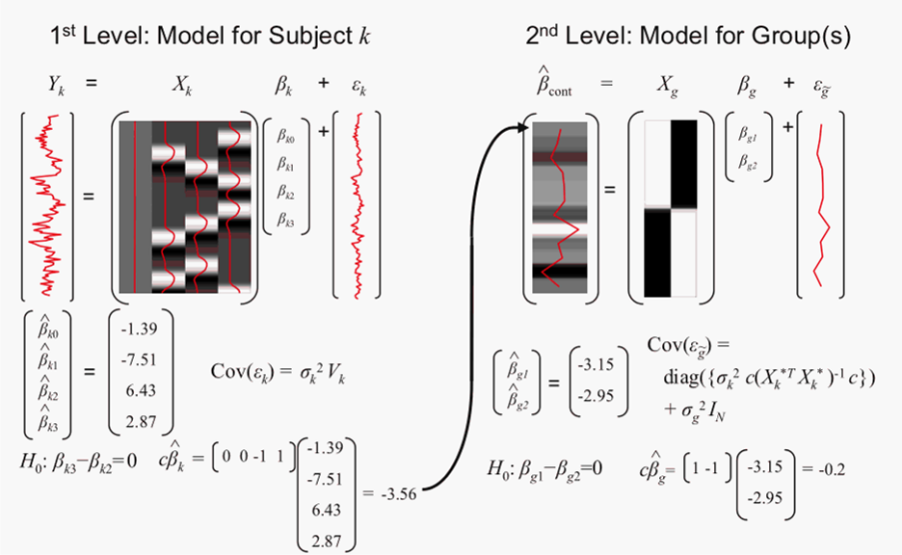
fMRI Data Analysis is 12 seconds
Intra-subject model for Subject k
Inter-subject group model
Previous result only for first level fMRI
2nd level fMRI doesn’t depend on 1st level P-values
Data quality also an issue

Slide 10
Functional MRI: Rest

Slide 11
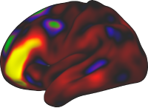
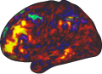
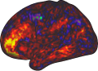
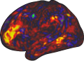
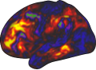
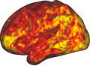
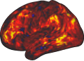
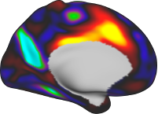
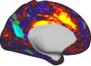
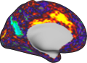
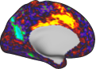
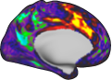
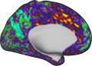
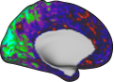
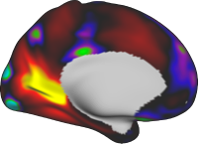
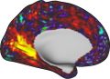
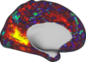
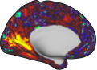
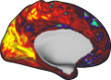
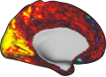
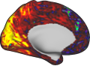
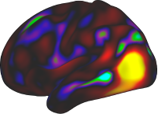
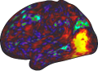
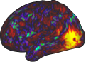
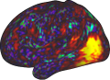
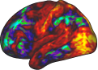
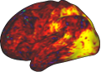
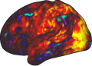
Group ICA
Dual Regression
Connectivity Maps
subject A
subject B
subject C
subject A
subject B
subject C
Tavor et al. (2016). Task-free MRI predicts individual differences in brain activity during task performance. Science

Slide 12
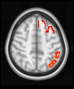
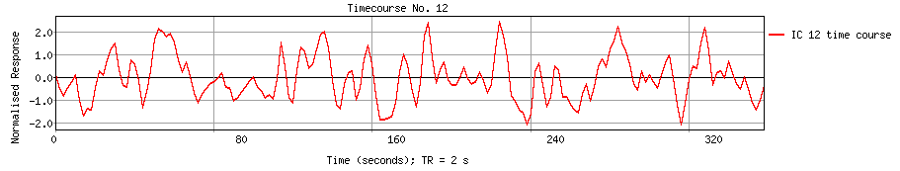
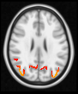
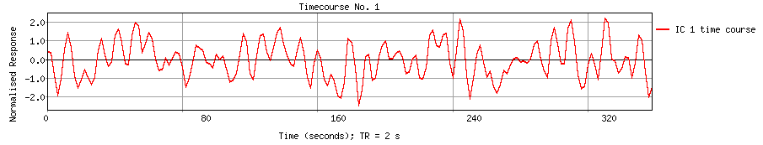
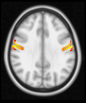
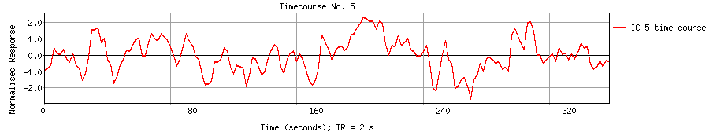
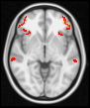
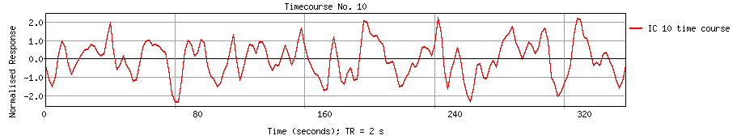
rsFMRI: Connectome
Resting State fMRI
Parcellations, Time series, Network Matrices
Partial Correlations
Network Matrix aka “NetMat”
Edges
Parcellation (common)
“Nodes” (subject-specific)
“Edges” (subject-specific)
Subjects

Slide 13
Outline
Introduction to Neuroimaging
Structural
Functional
Population Neuroimaging
Human Connectome project
UKBIobank
Fingerprinting

Slide 14
Population Neuroimaging
Group differences
Sample size
Individual differences
Predict behavior from image

Slide 15
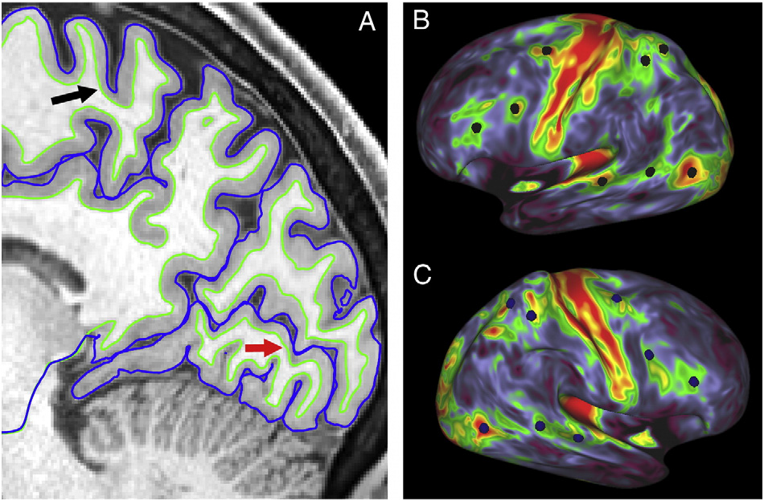
Human Connectome Project http://www.humanconnectome.org
5 year, US$30m NIH contract
Wash. U. StL + U. Minn.
1,200 subjects
Population sample
Subjects drawn from state birth records
Twins+siblings design, ≈300 families of ≈4
Cutting edge MRI
fMRI + rs-fMRI + dMRI
Extensive non-imaging
478 variables on behavior, health, medical history
All data openly shared
Allows unprecedented methodological development
Van Essen et al. (2013). The WU-Minn Human Connectome Project: An overview. NeuroImage, 80, 62–79.

Slide 16
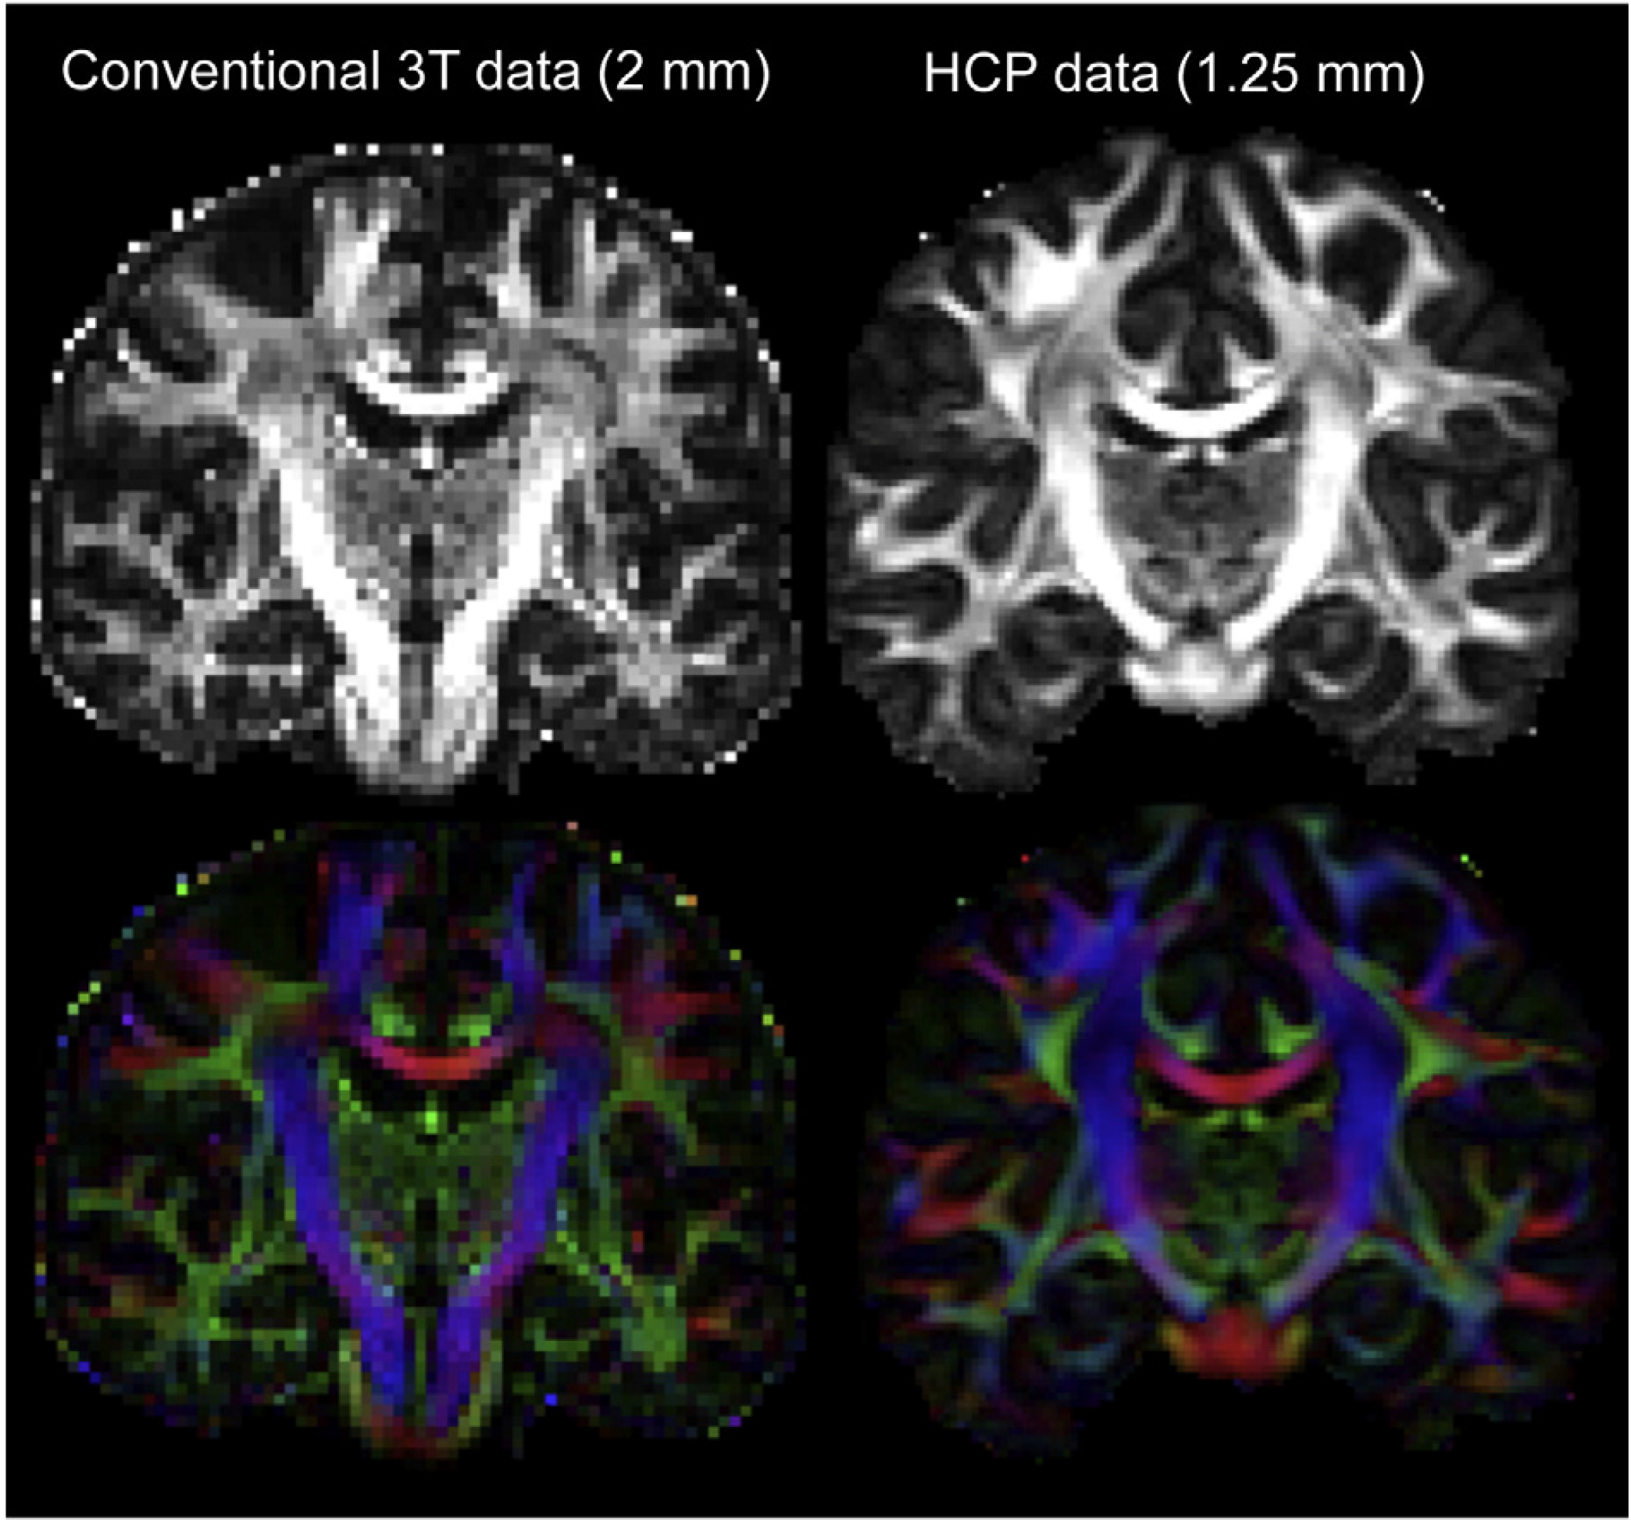
Human Connectome Project
All data freely available
‘1-click’ authorization
All imaging data
Coarsened age
Basic behavioral
With signed authorization
All variables
No project review!
FA
Principal Direction

Slide 17
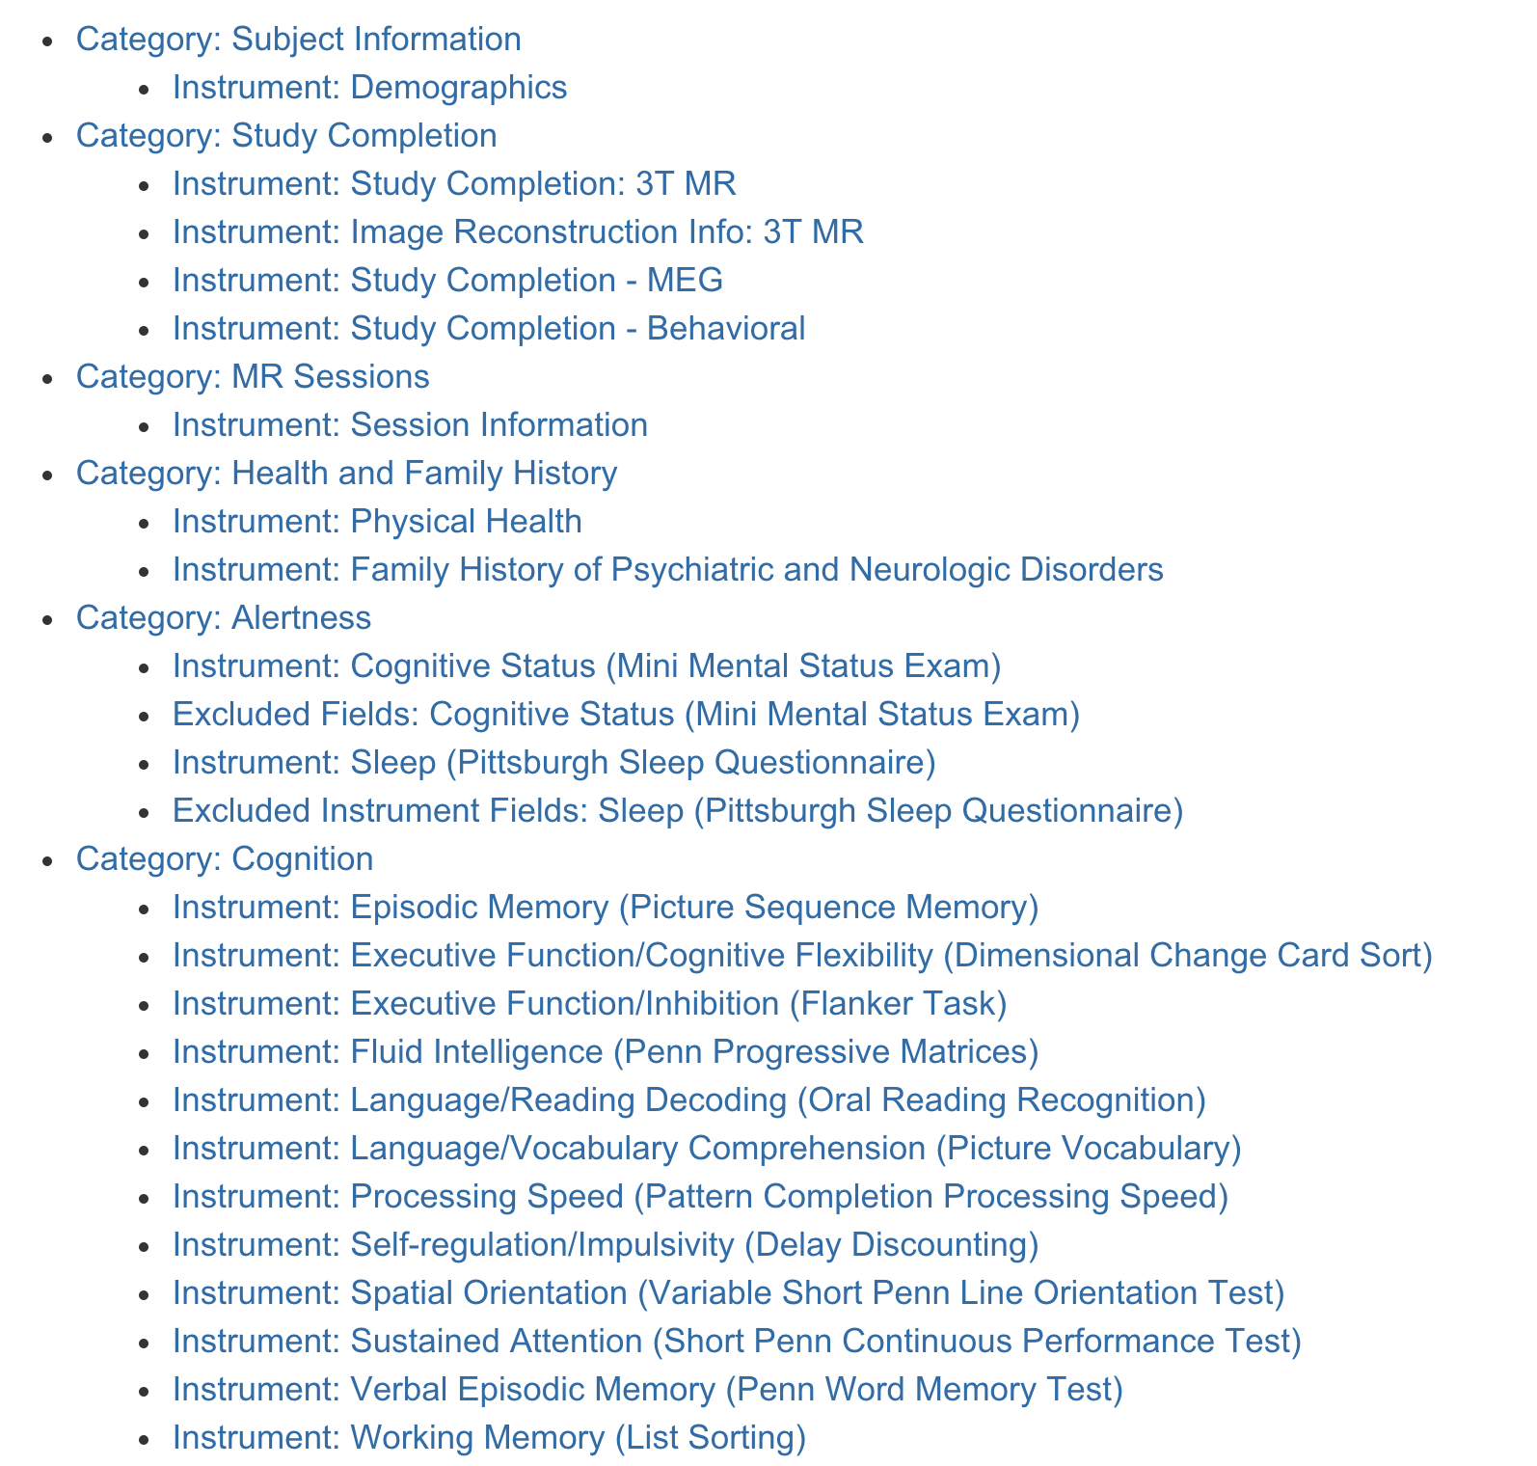


Human Connectome Project
Target sample
n=1,200 (300 families of 4)
Extensive testing
478 variables
Categories
Subject Information
Health & Family History
Altertness
Cognition
Emotion
Motor
Personality
Psychiatric & Life Function
Sensory
Substance Abuse
Many tests from “NIH Toolbox for the Assessment of Neurological and Behavioral Function ”
http://www.nihtoolbox.org

Slide 18


HCP Application (1)
Predicting task activation from resting state data
Features: Resting Functional & Structural
Theory- of-Mind Task
98 features
9 features
Relational Cognition Task
Tavor et al. (2016). Task-free MRI predicts individual differences in brain activity during task performance. Science, 352(6282), 216–220.

Slide 19
HCP Application (2): Predict each SM with NetMat
Network Matrix (NetMat) for each subject
50×(50-1)/2 = 1,225 unique edges
Also tried for networks with 25, 50, 100 & 200 nodes
Partial correlation (r2z) between each node
“Subject Measures” (SM) for each subject
280 behavioral and demographic measures
Fluid IQ, life satisfaction, stress, dexterity, smoking, alcohol/drug use, sleep quality, …

Slide 20

UK Biobank: Sampling Design
2006-2010: 9.2 million individuals contacted
Drawn from NHS registers
Aged 40–69 years
Living within 40 km of one of 22 assessment centres in England, Wales, and Scotland
503,317 consented & had baseline assessment
5.5% response rate
Fry et al. (2017). Am. J of Epid, 186, 1-9. http://doi.org/10.1093/aje/kwx246

Slide 21
Big Data in UK Biobank
Genetics
Genotyping: 11,734,353 SNPs (all subjects)
Sequencing (planned)
Imaging
100,000 planned, ~20k so far
MRI: T1, T2 FLAIR, SWI, dMRI, rs-fMRI t-fMRI
Distilled into 3,144 “Image-Derived Phenotypes” IDP

Slide 22

UK Biobank: Imaging Extension
2006-2010
Baseline assessment of 500,000
2014-
Imaging of 100,000 UKB subjects
Brain MRI, Heart MRI, Carotid ultrasound, Dexa
Brain MRI
T1, T2 FLAIR, T2*, r-fMRI, t-fMRI, dMRI & SWI
Customised FSL pipeline by S. Smith, F. Alfaro-Almagro et al.
Generates 1000’s of “Image-Derived Phenotypes” (IDPs)
2018-
2-year re-scan of 10,000 subjects

Slide 23



Powerful even with ‘just’ N=8,000
d
Miller, et al. (2016). Nature Neuroscience, 19(11), 1523–1536.

Slide 24
Slide: S. Smith

Slide 25
Go to latex

Slide 26
UKBB
Miller etal 2016, doi:10.1038/nn.4393

Slide 27

UKBB: CCA

